Slide 1
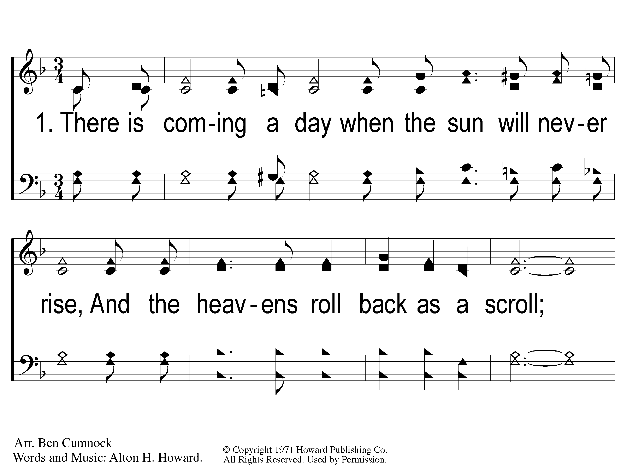
1-1 Home Safe With Him At Last
Home Safe With Him At Last
83

Slide 2
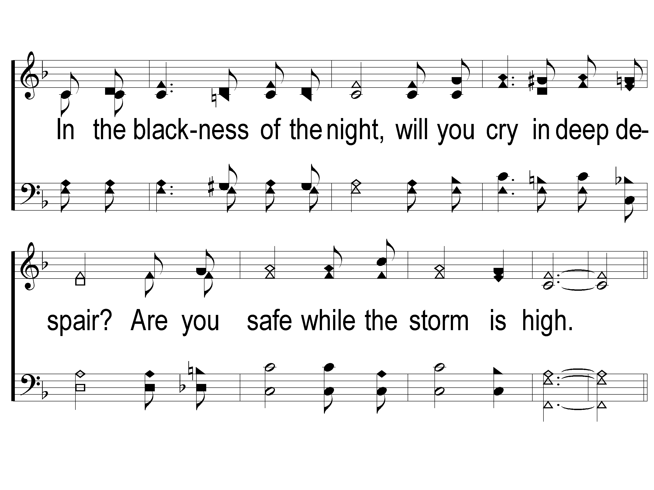
1-2 Home Safe With Him At Last
Home Safe With Him At Last
83

Slide 3
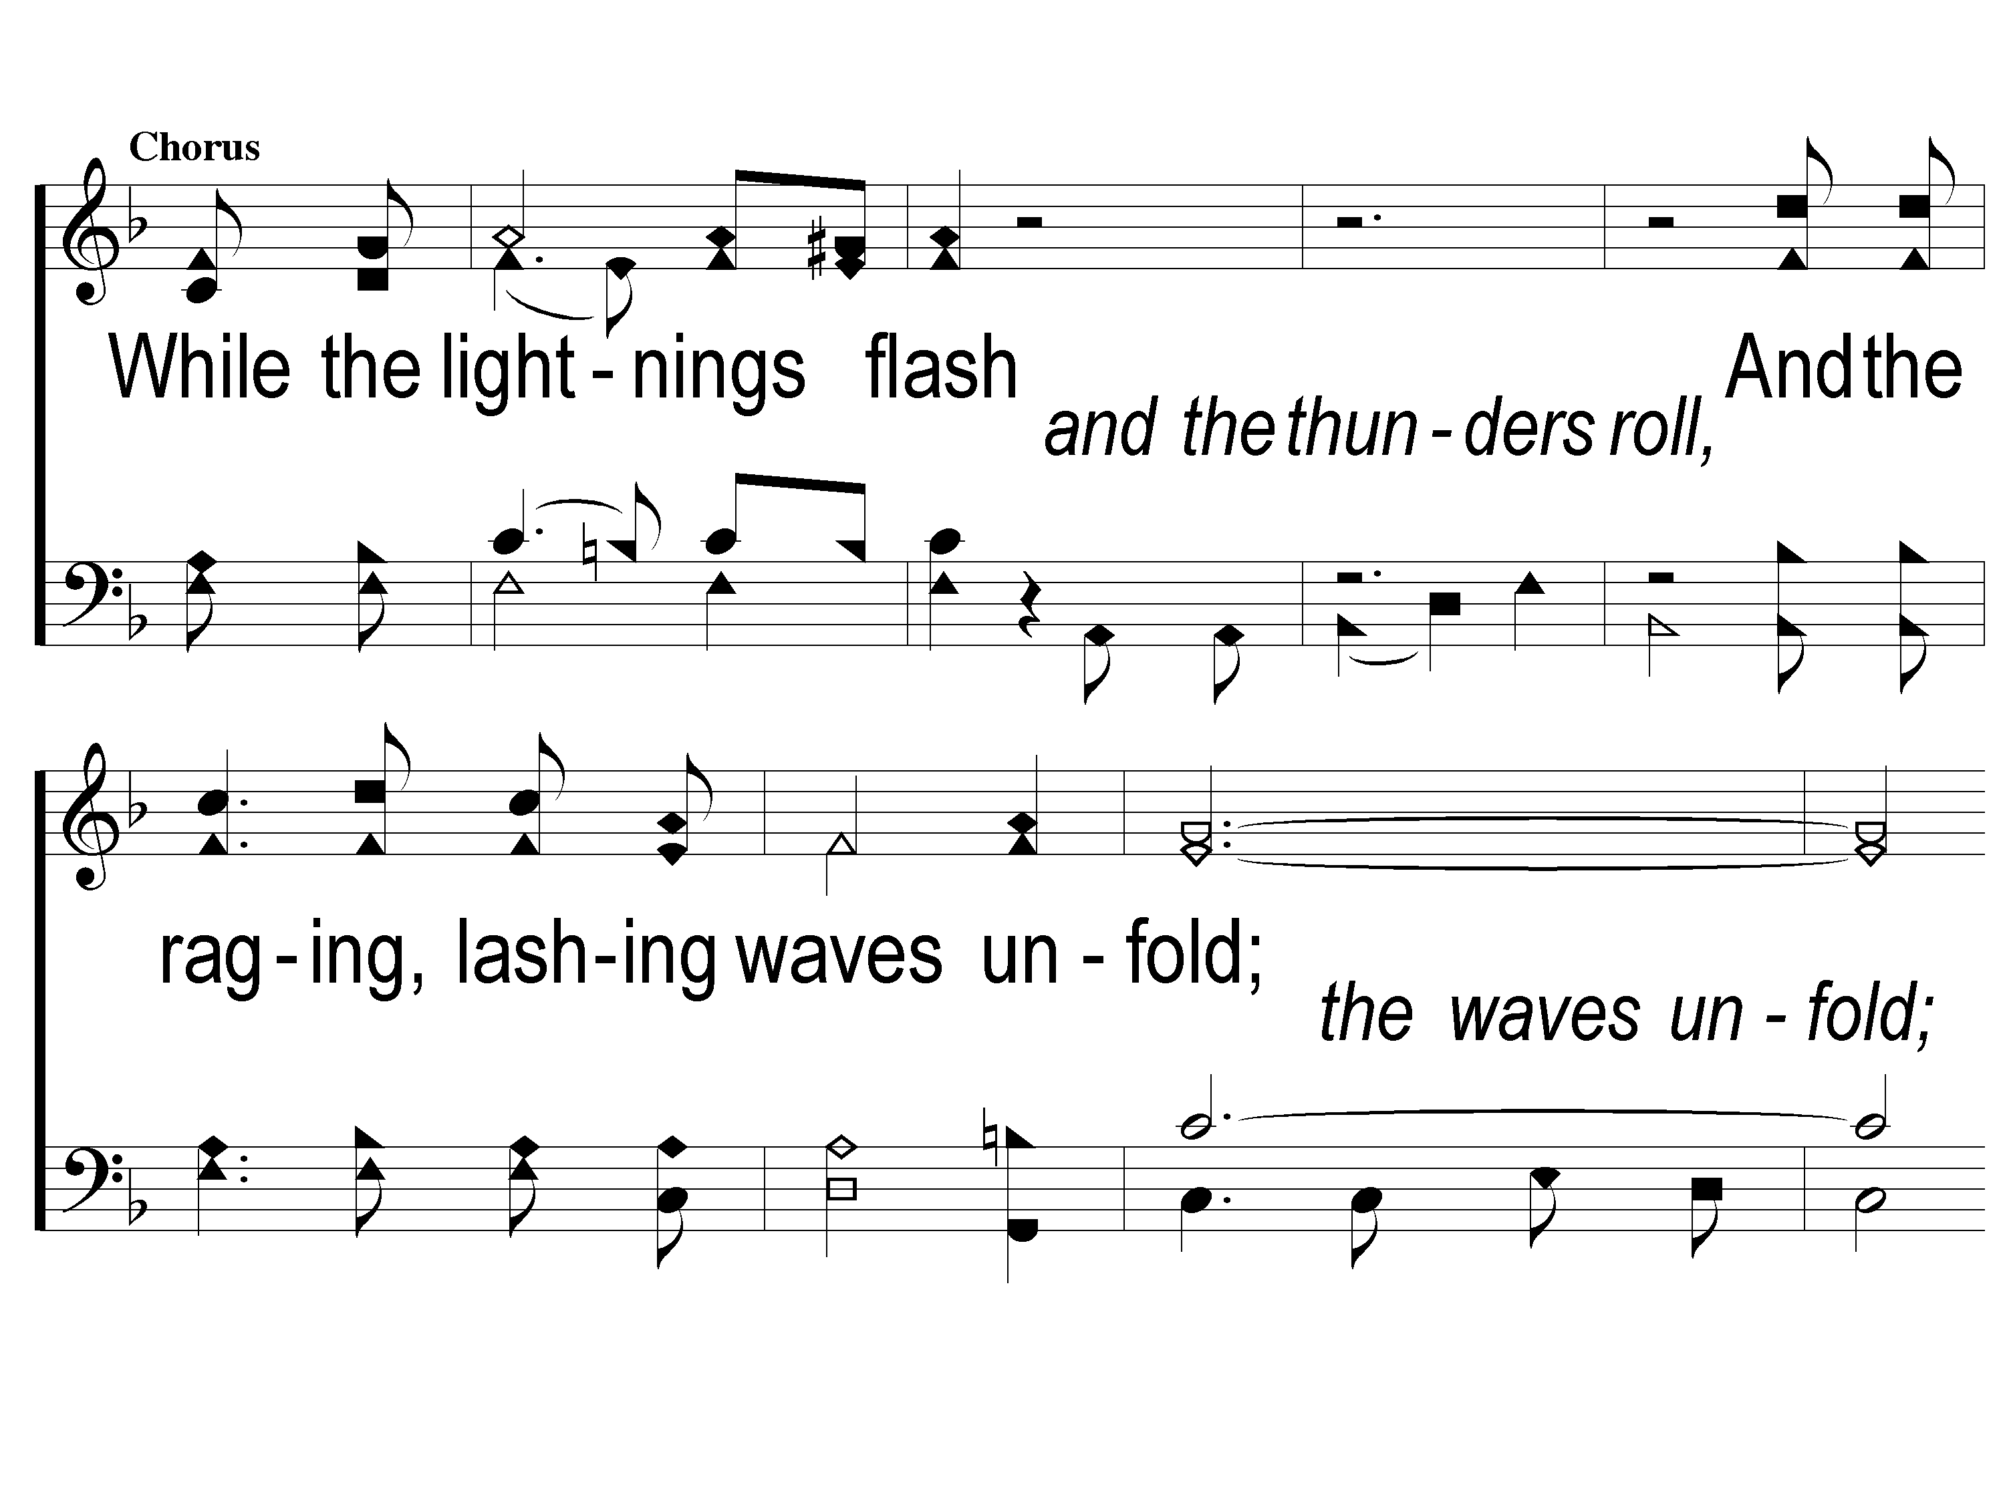
C-1 Home Safe With Him At Last
Home Safe With Him At Last
83

Slide 4
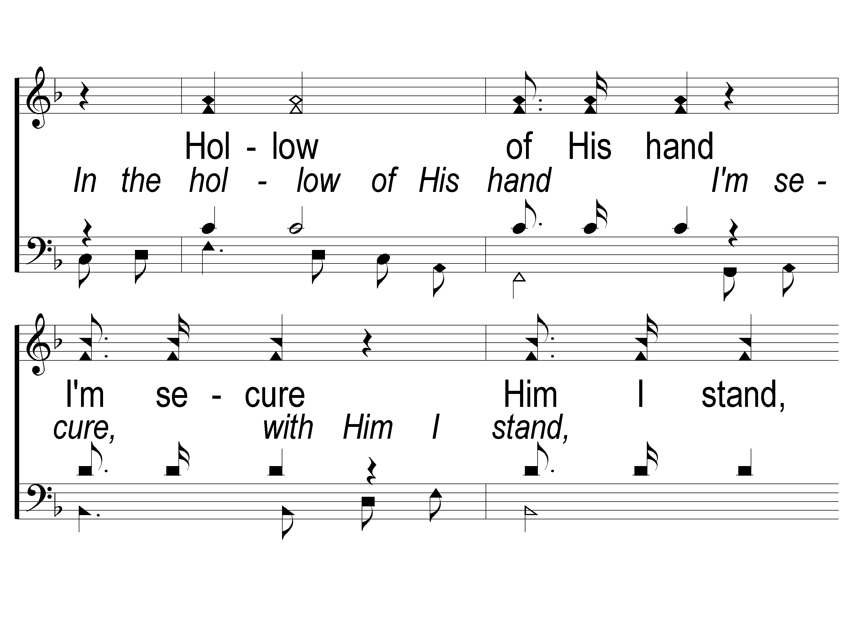
C-2 Home Safe With Him At Last
Home Safe With Him At Last
83

Slide 5
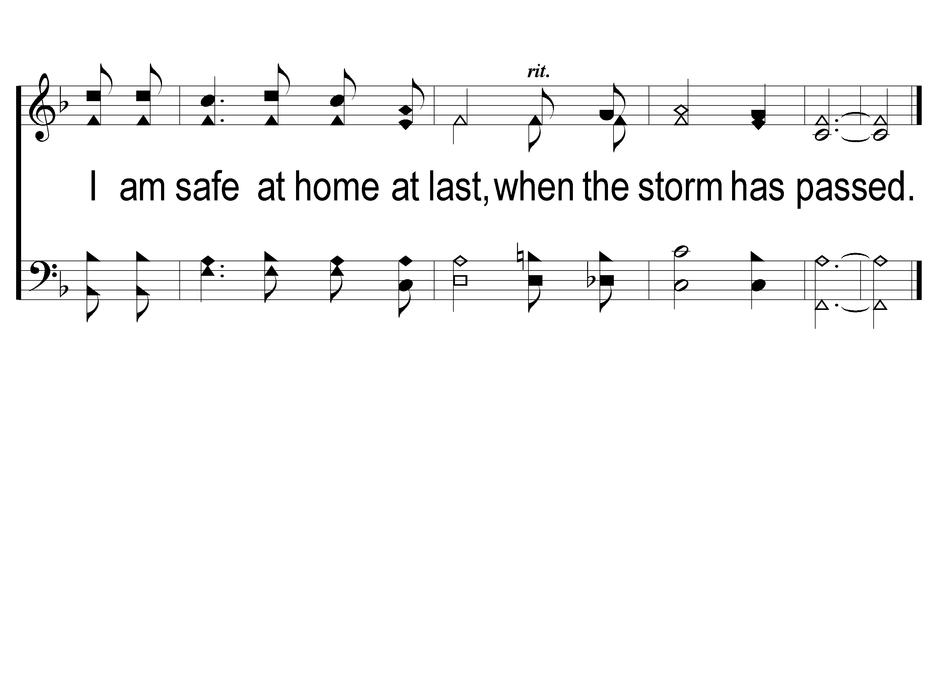
C-3 Home Safe With Him At Last
Home Safe With Him At Last
83

Slide 6
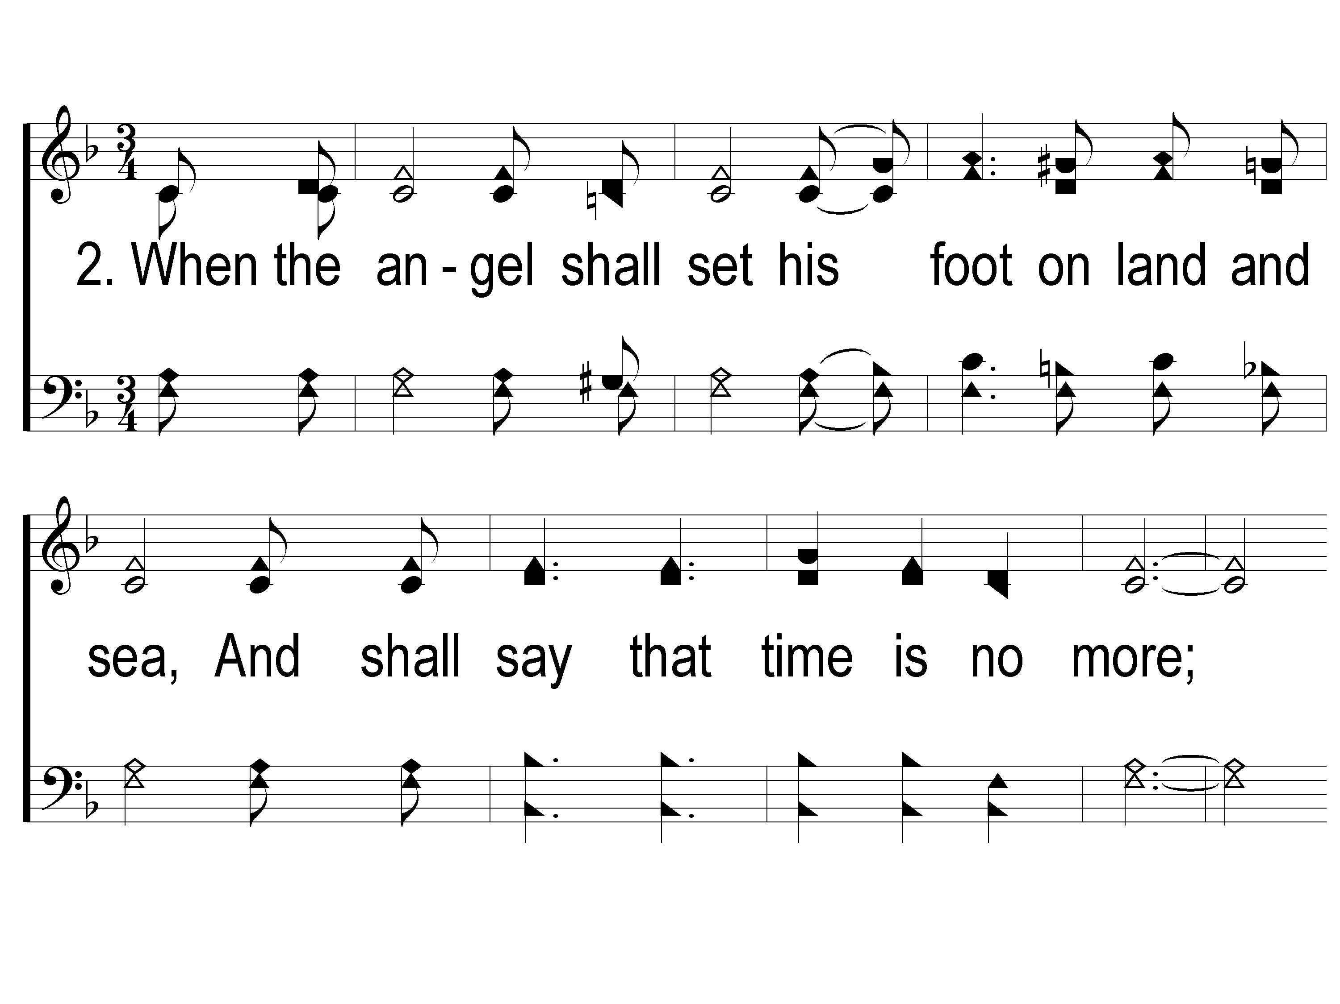
2-1 Home Safe With Him At Last
Home Safe With Him At Last
83

Slide 7
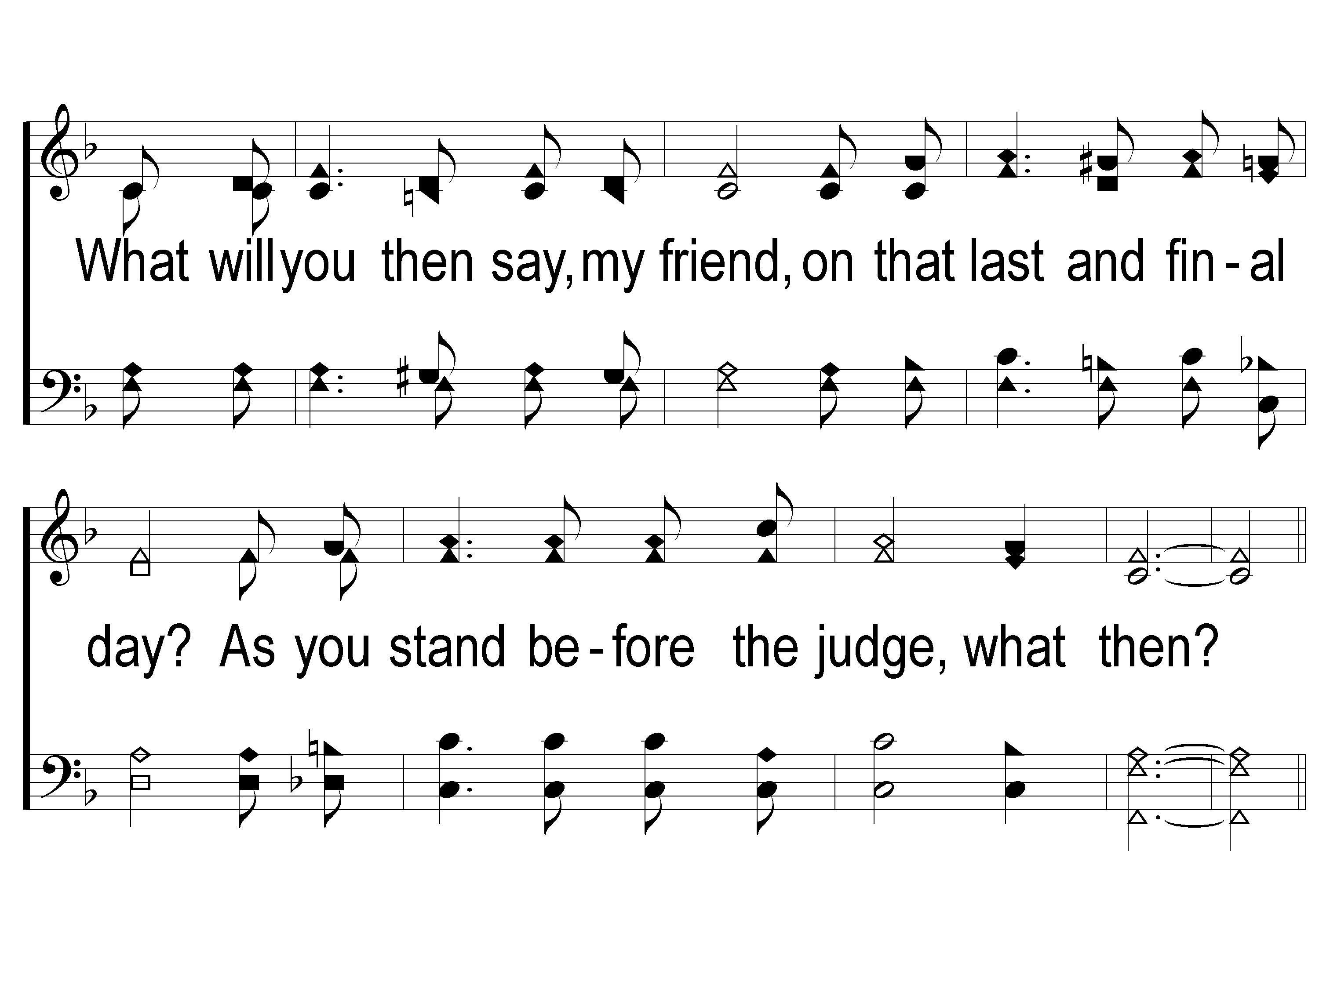
2-2 Home Safe With Him At Last
Home Safe With Him At Last
83

Slide 8
C-1 Home Safe With Him At Last
Home Safe With Him At Last
83

Slide 9
C-2 Home Safe With Him At Last
Home Safe With Him At Last
83

Slide 10
C-3 Home Safe With Him At Last
Home Safe With Him At Last
83

Slide 11
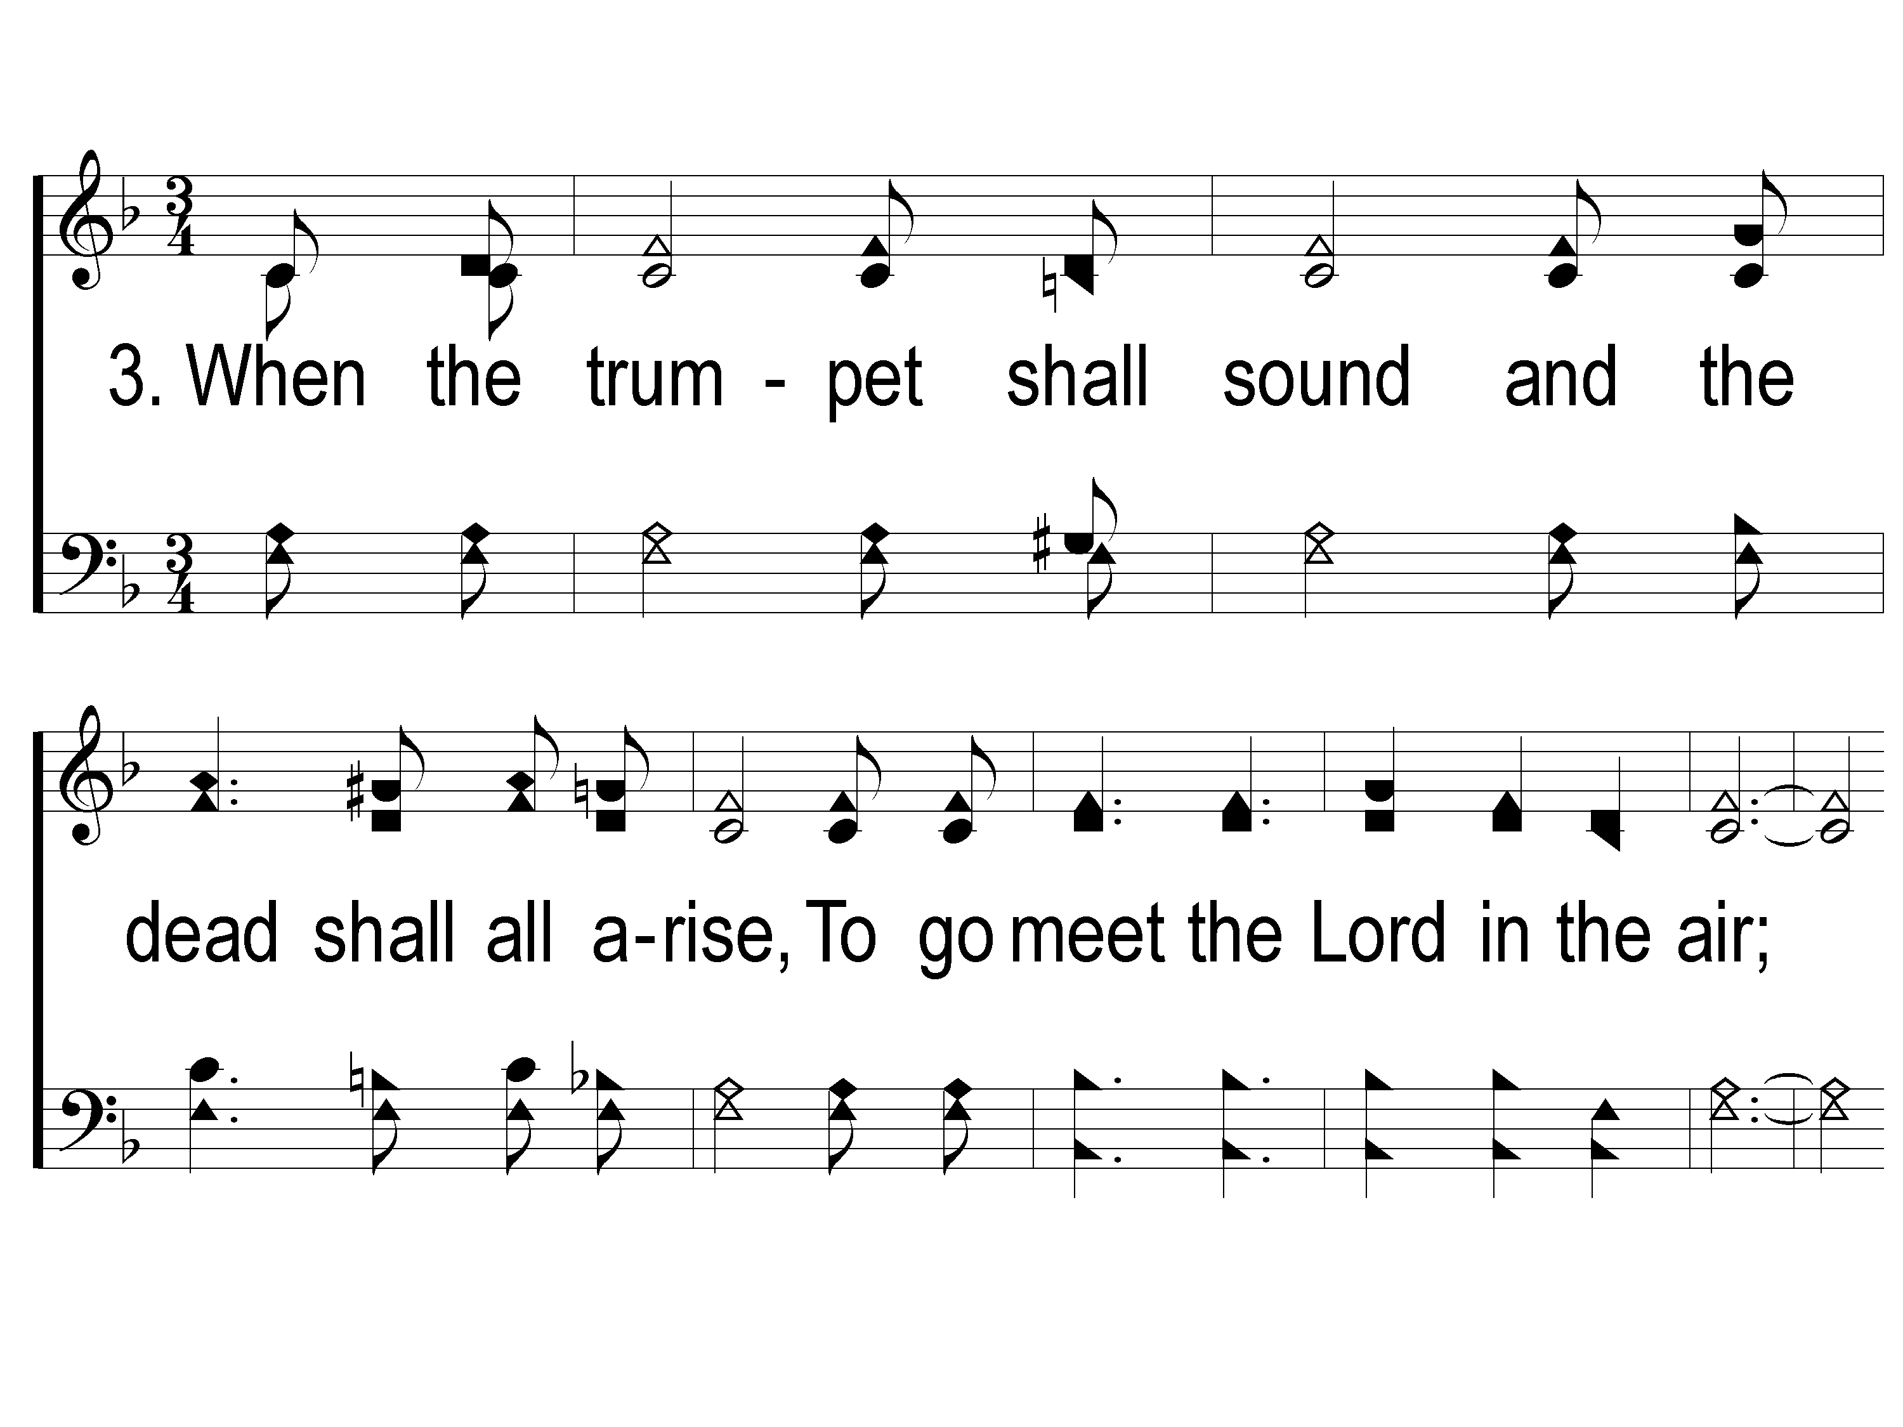
3-1 Home Safe With Him At Last
Home Safe With Him At Last
83

Slide 12
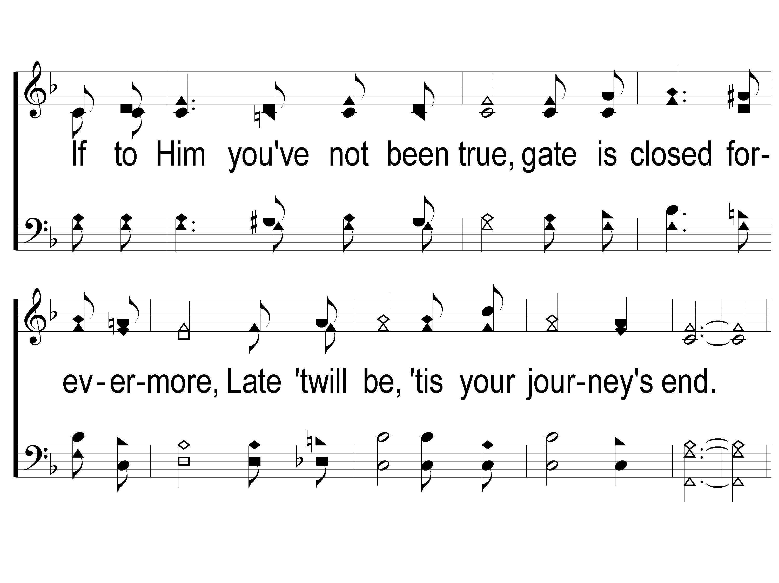
3-2 Home Safe With Him At Last
Home Safe With Him At Last
83

Slide 13
C-1 Home Safe With Him At Last
Home Safe With Him At Last
83

Slide 14
C-2 Home Safe With Him At Last
Home Safe With Him At Last
83

Slide 15
C-3 Home Safe With Him At Last
Home Safe With Him At Last
83

